Slide 1
Credentials
Google Search

Slide 2
Google Search
Step 1 :
Create a Search Engine programmablesearchengine.google.com
Copy the Search Engine ID
Step 2 :
Create a Google Cloud Project API Key console.cloud.google.com
Create a new Project
Enable Custom Search JSON API
Create Credentials - API Key

Slide 3
Step 1

Slide 4
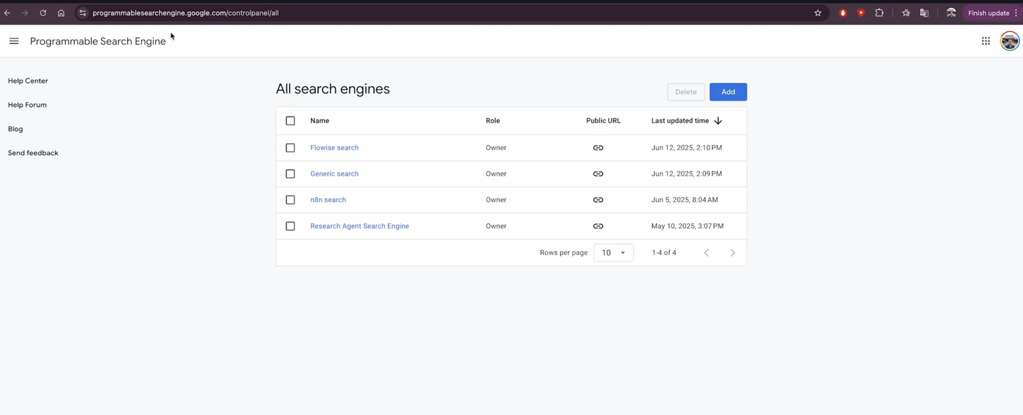
Go to website : programmablesearchengine.google.com

Slide 5
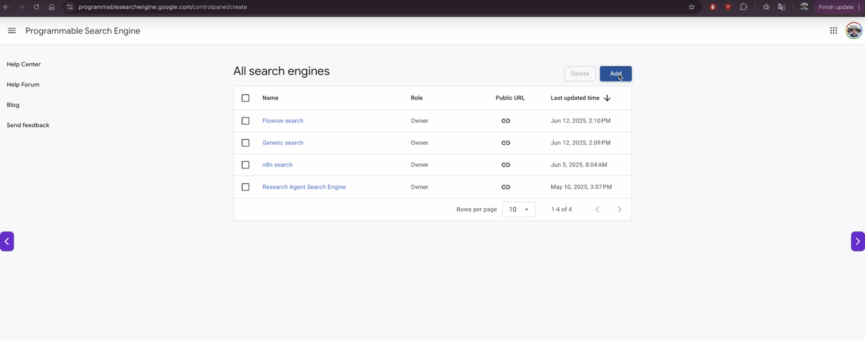
Click on Add

Slide 6
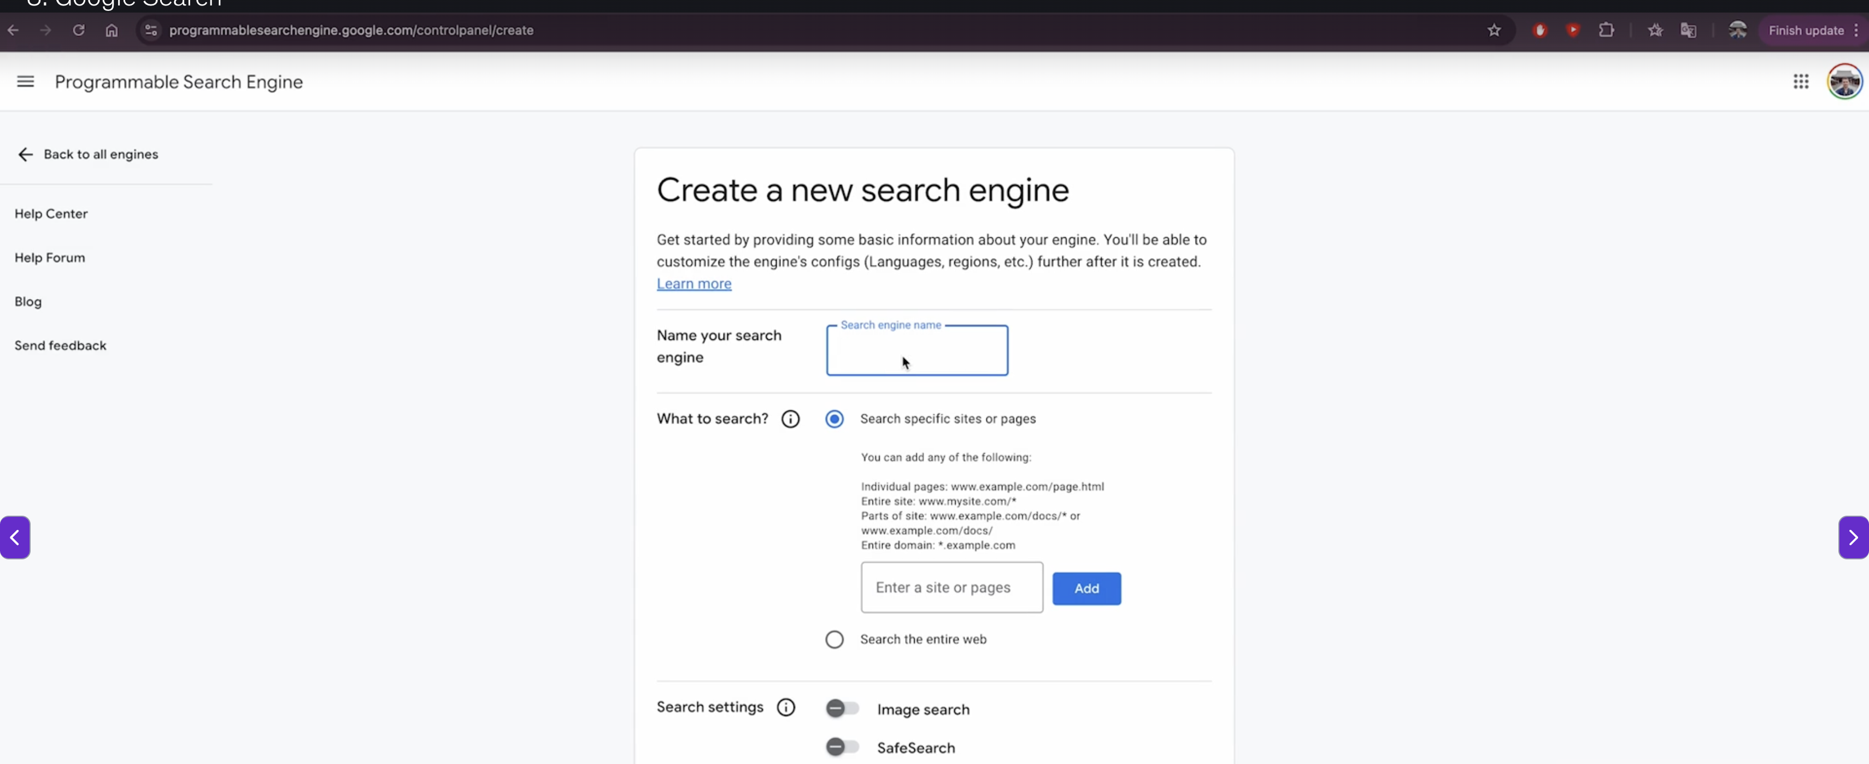
Name your Search Engine

Slide 7
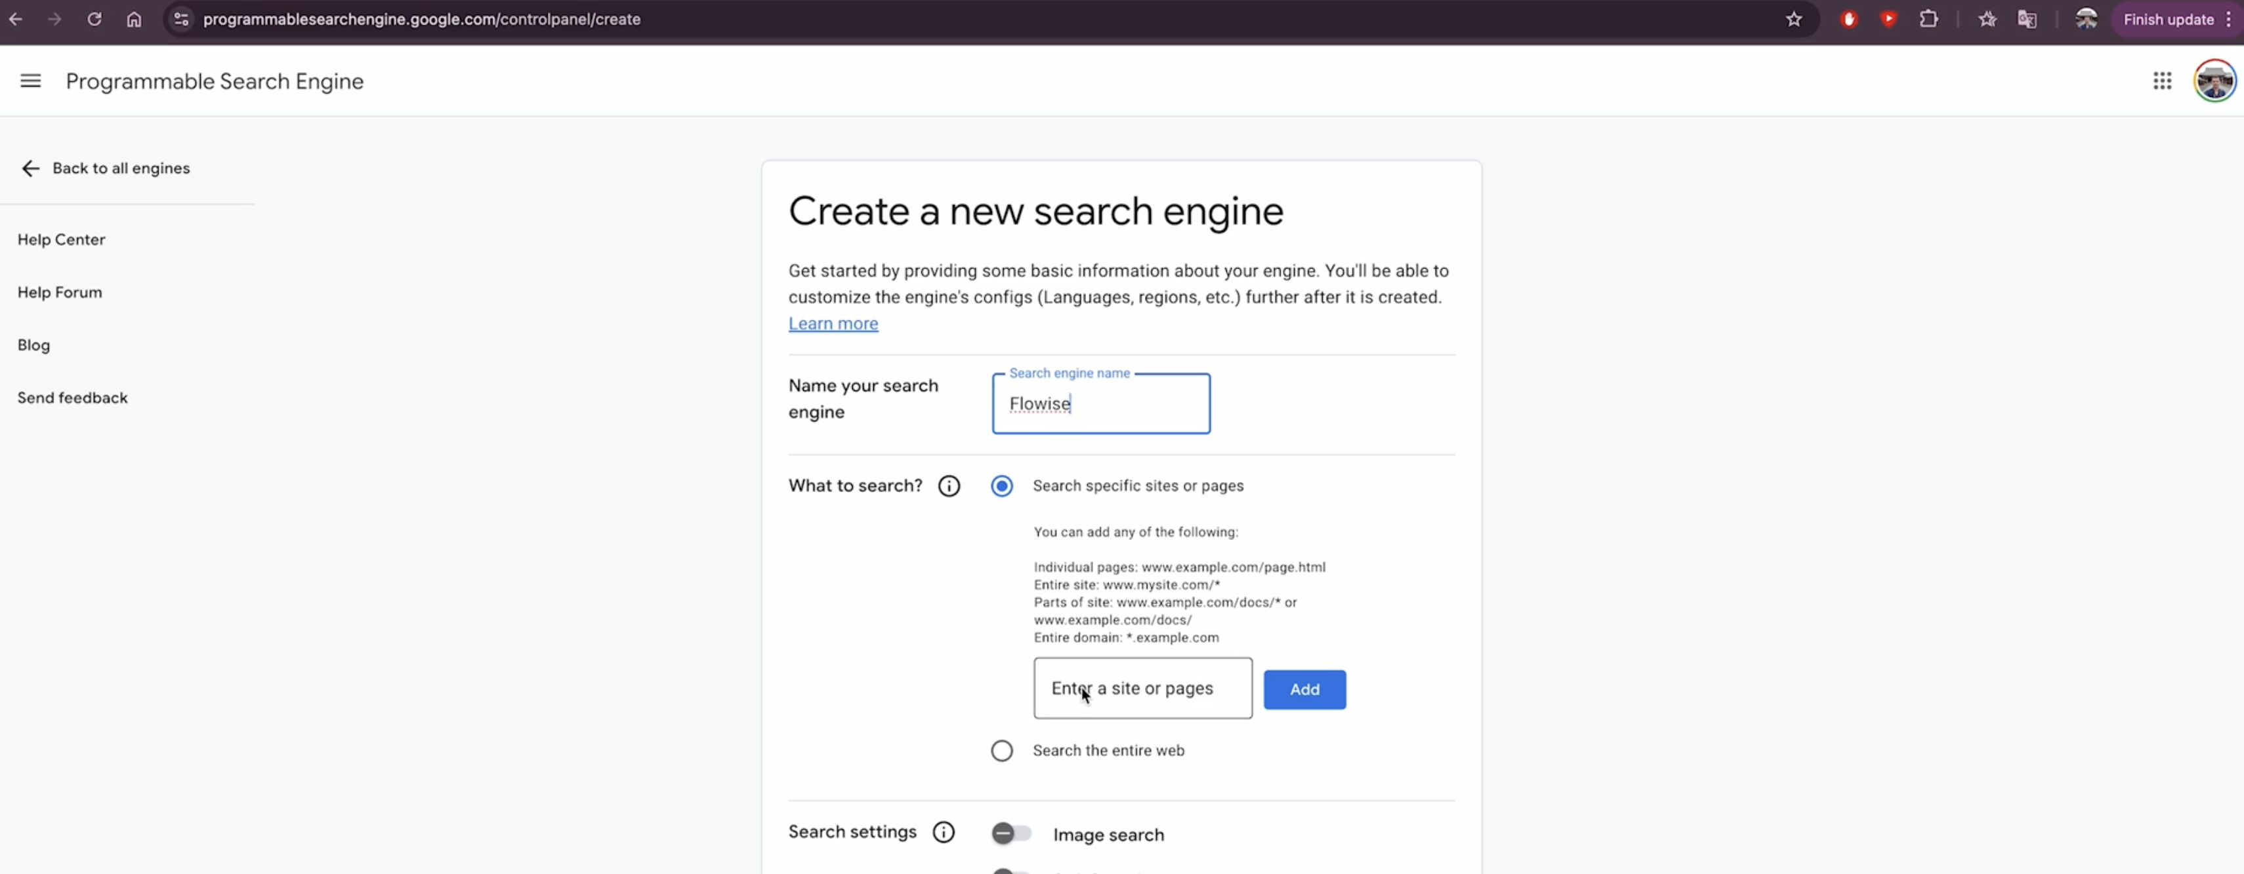
For eg – I have named it as Flowise

Slide 8
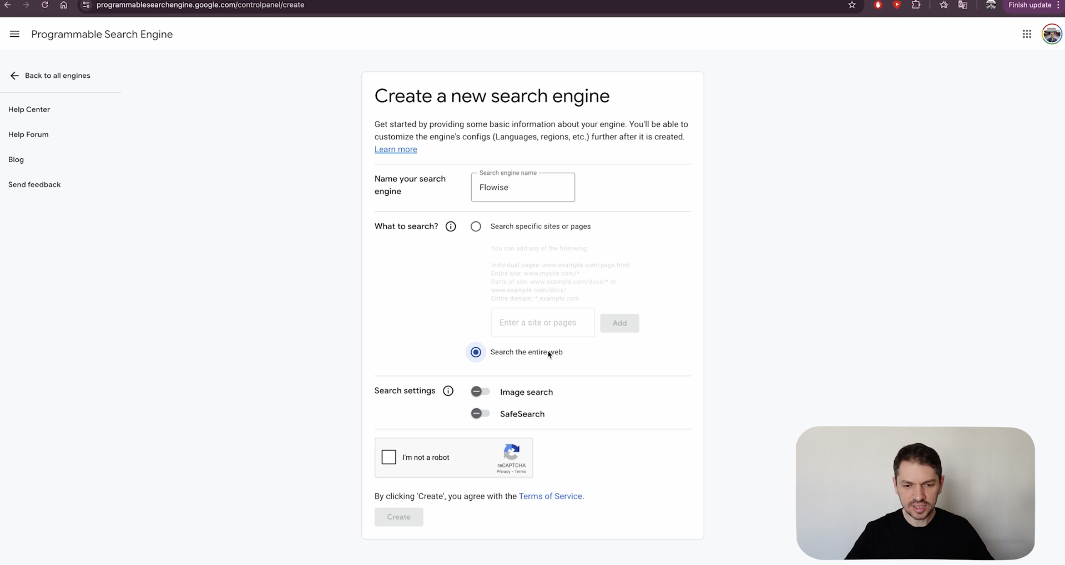
Select ”Search the entire web”

Slide 9
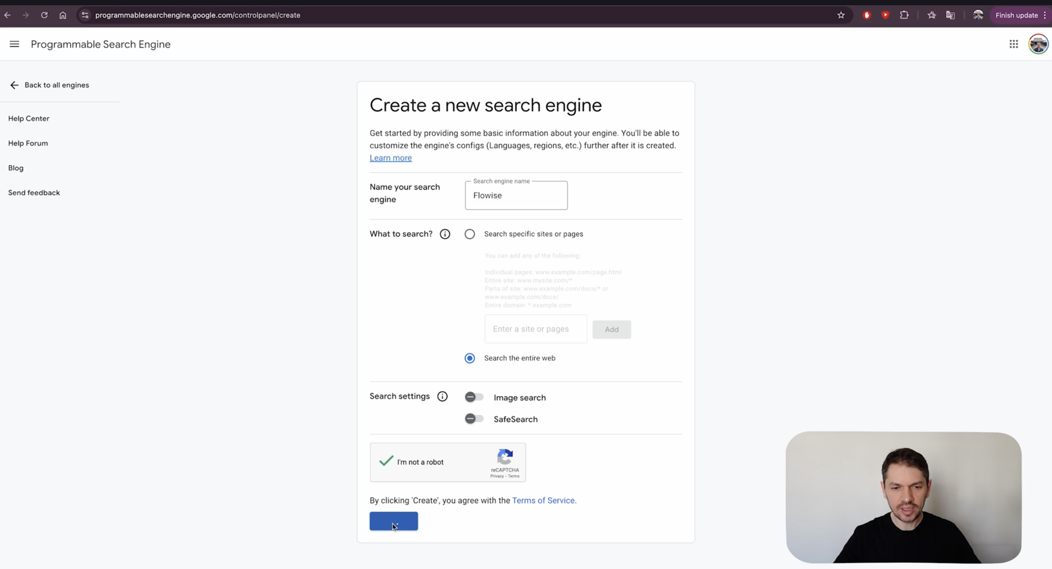
Select “I am not a robot” and then “Create”

Slide 10
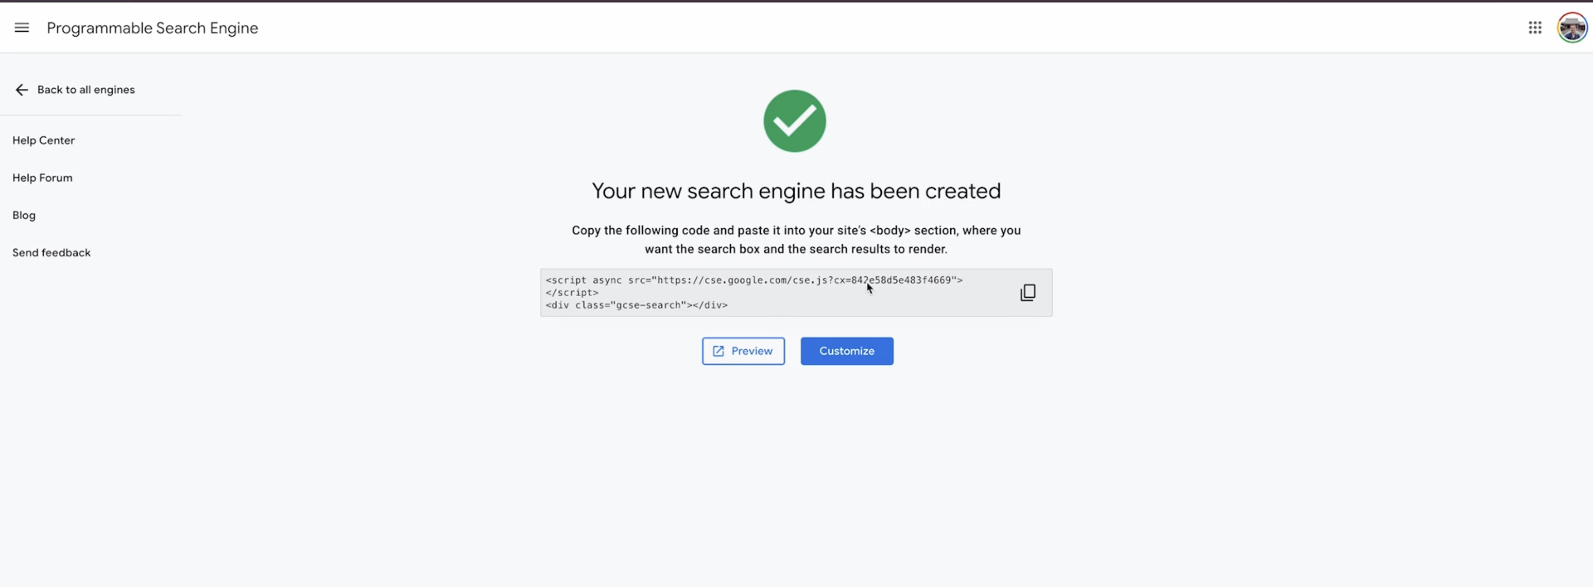
You will get this message !

Slide 11
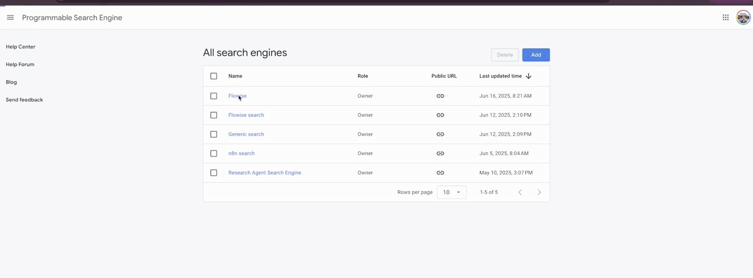
Go back to main screen and you will find your project created,in our case ,it was Flowise

Slide 12
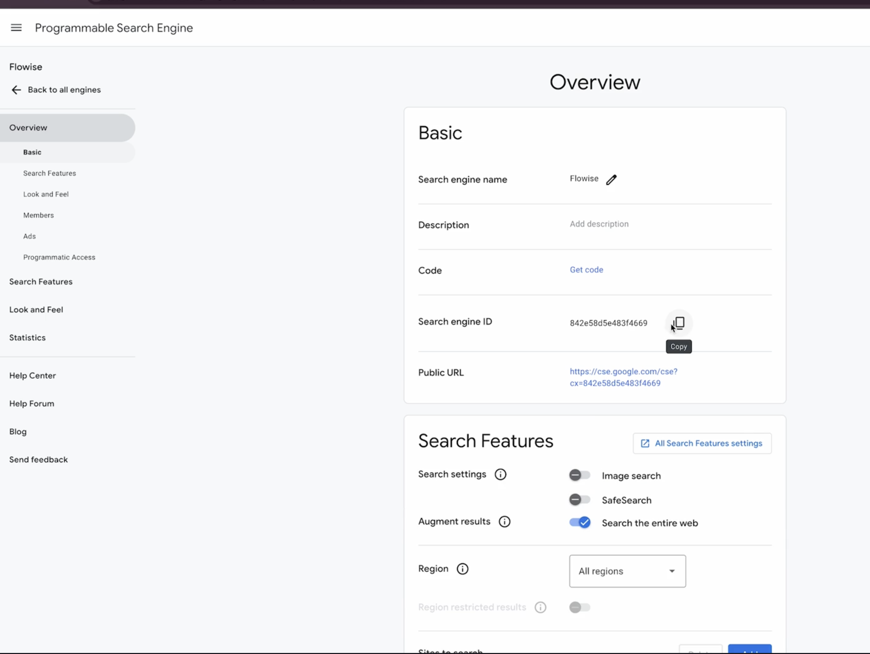
Copy the Search Engine ID

Slide 13

You are done with :
Create a Search Engine programmablesearchengine.google.com
Copy the Search Engine ID

Slide 14
Step 2

Slide 15
Create a Google Cloud Project API Key console.cloud.google.com Create a new Project Enable Custom Search JSON API Create Credentials - API Key

Slide 16
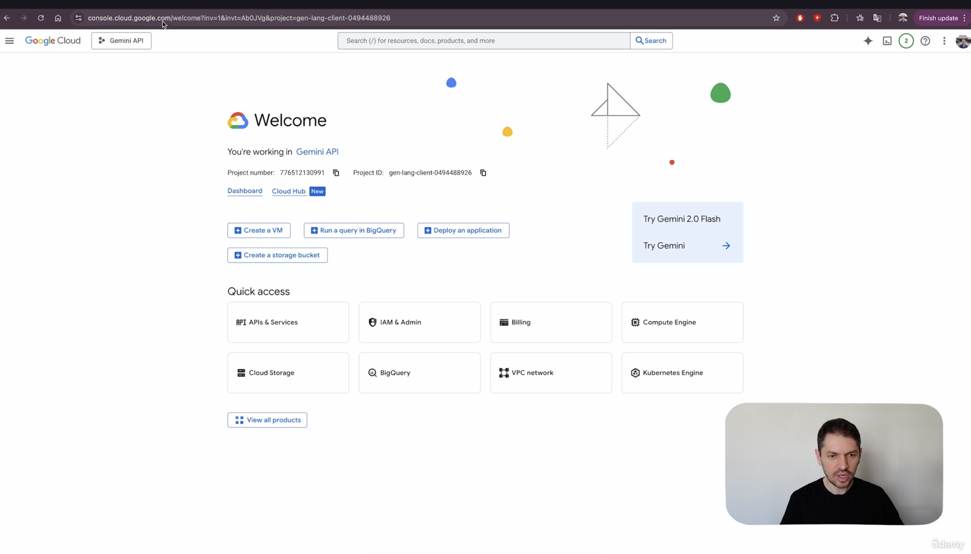
Go to console.cloud.google.com

Slide 17
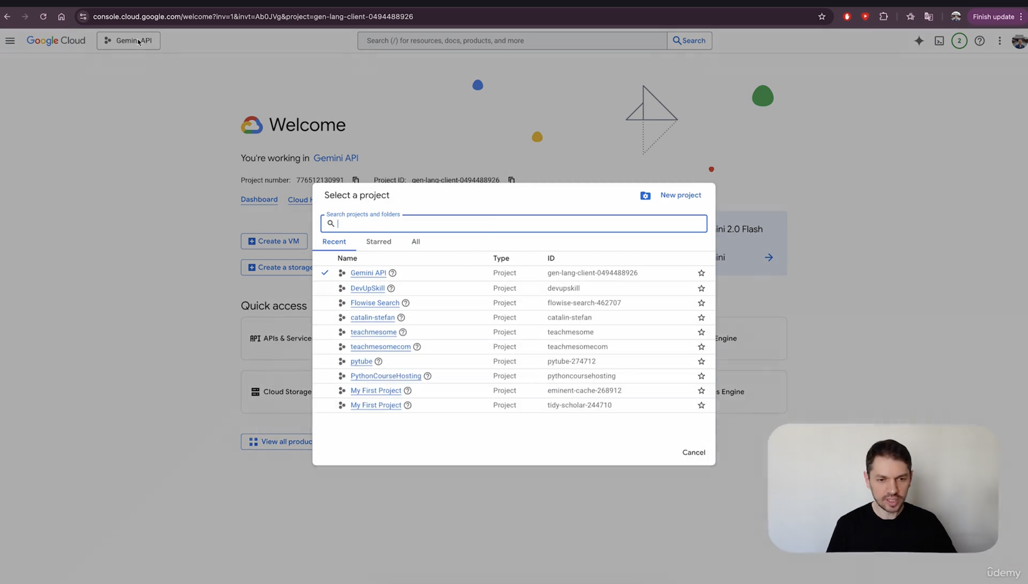
Click here to open projects
Click on “New Project” to create a new project

Slide 18
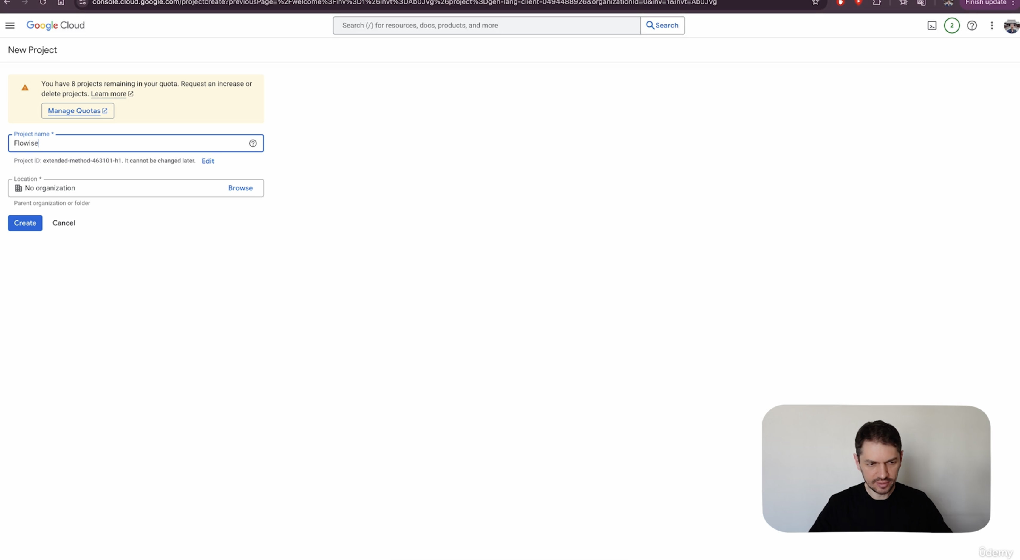
Name the project , in this case , we have chosen name as “Flowise”, you can choose anything you like

Slide 19
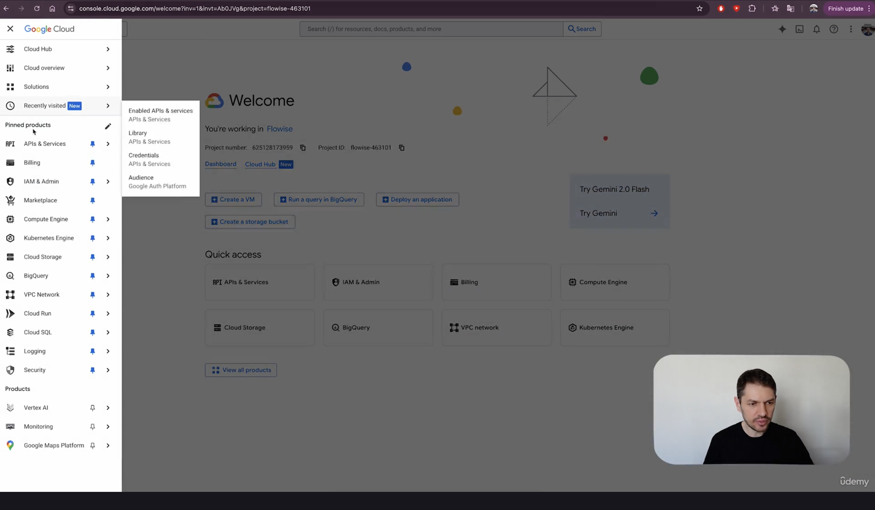
On the left hand side menu , go to “API’s & Services”
In “API’s & Services”,select ”Library”

Slide 20
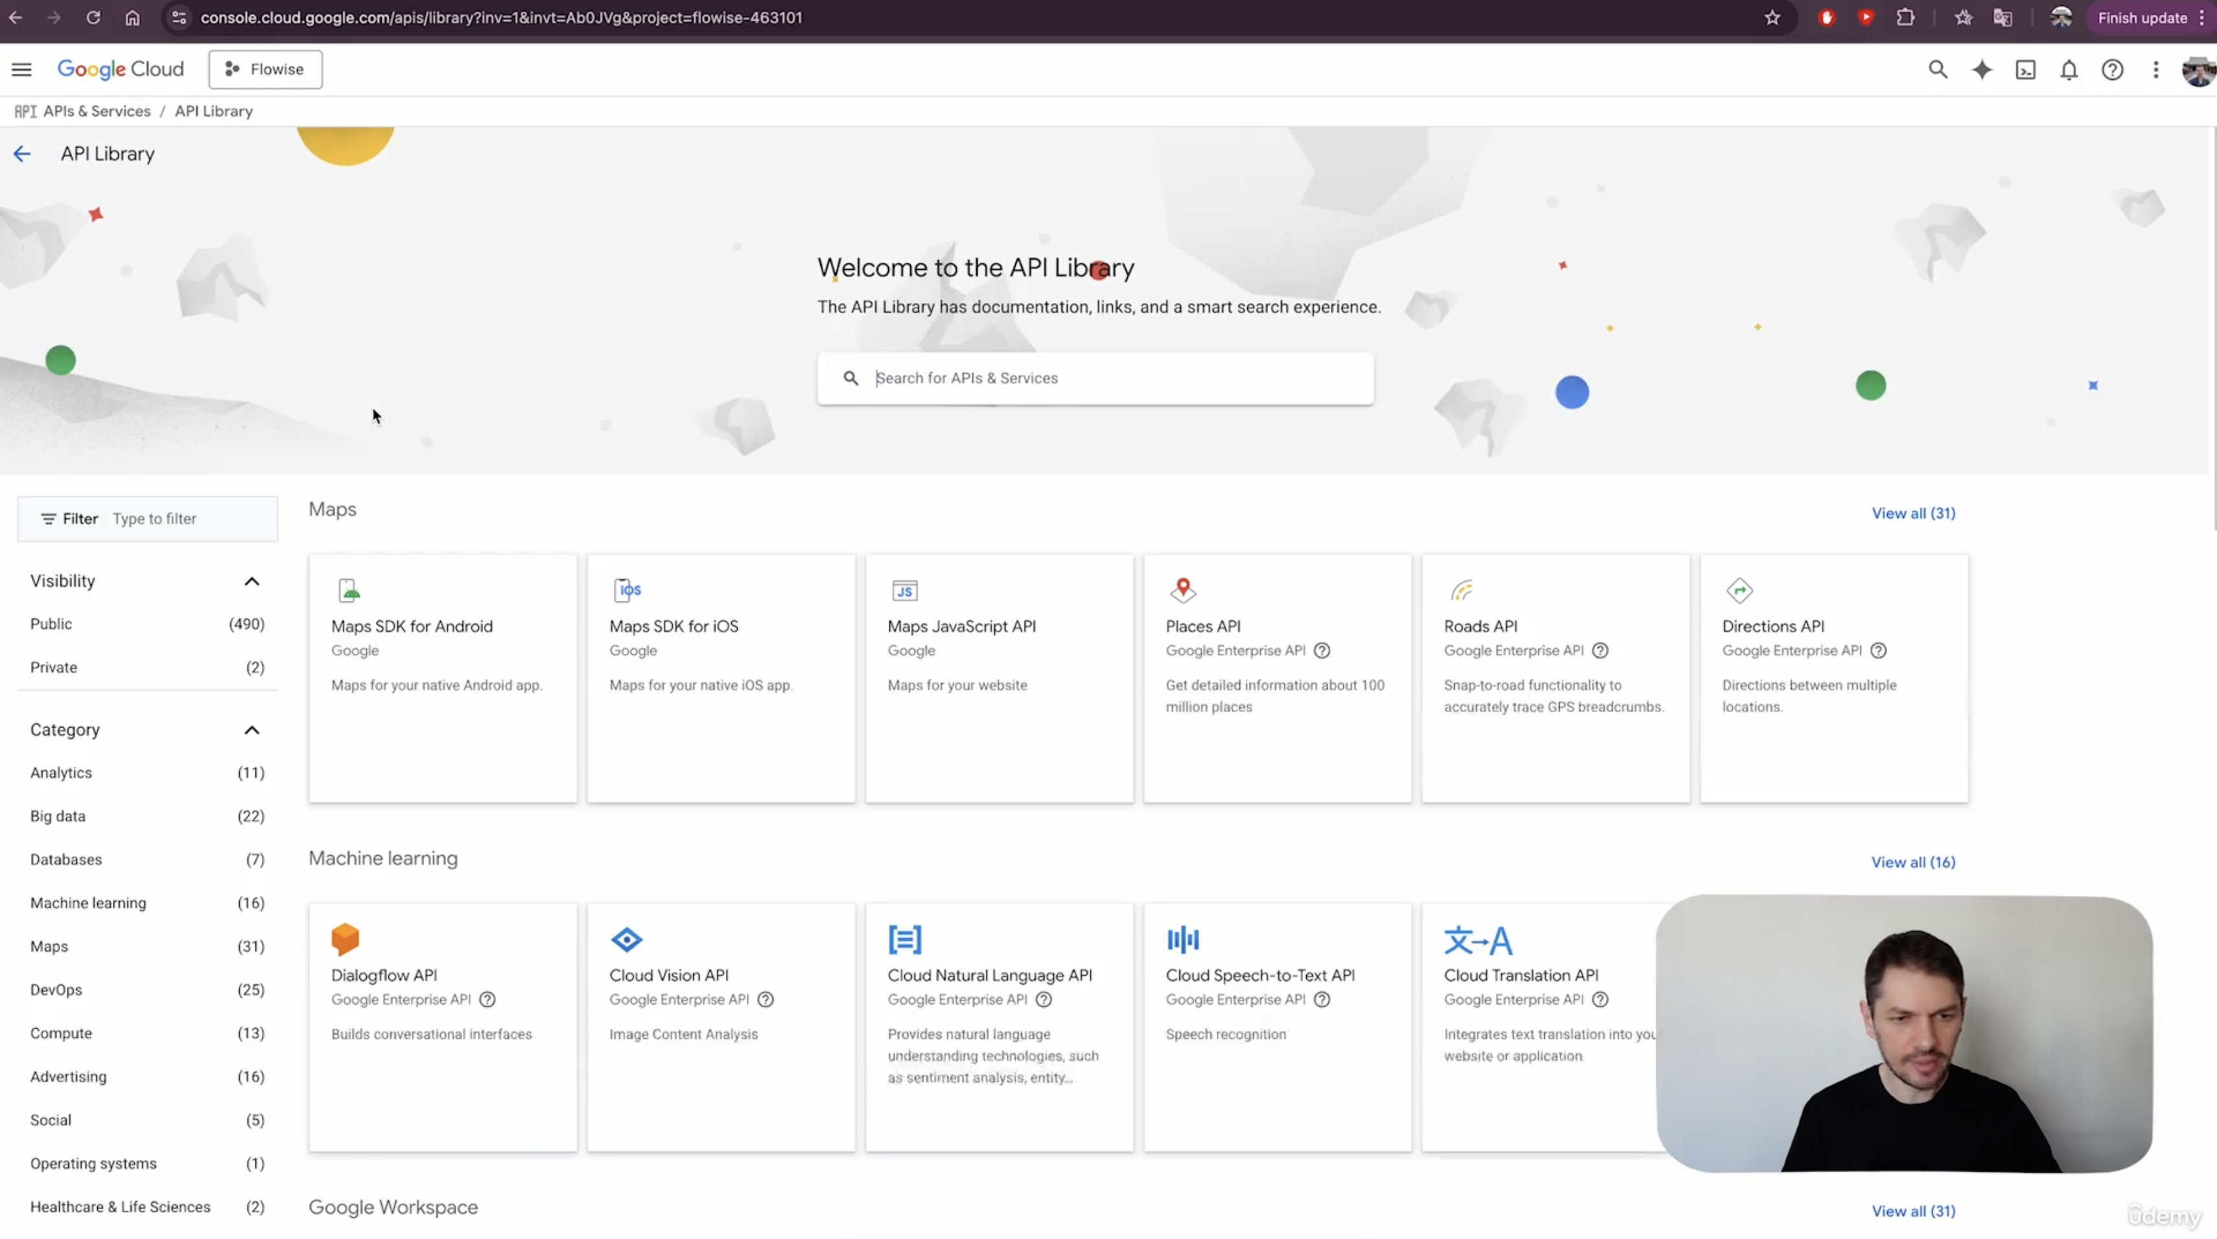
You will land on this screen

Slide 21
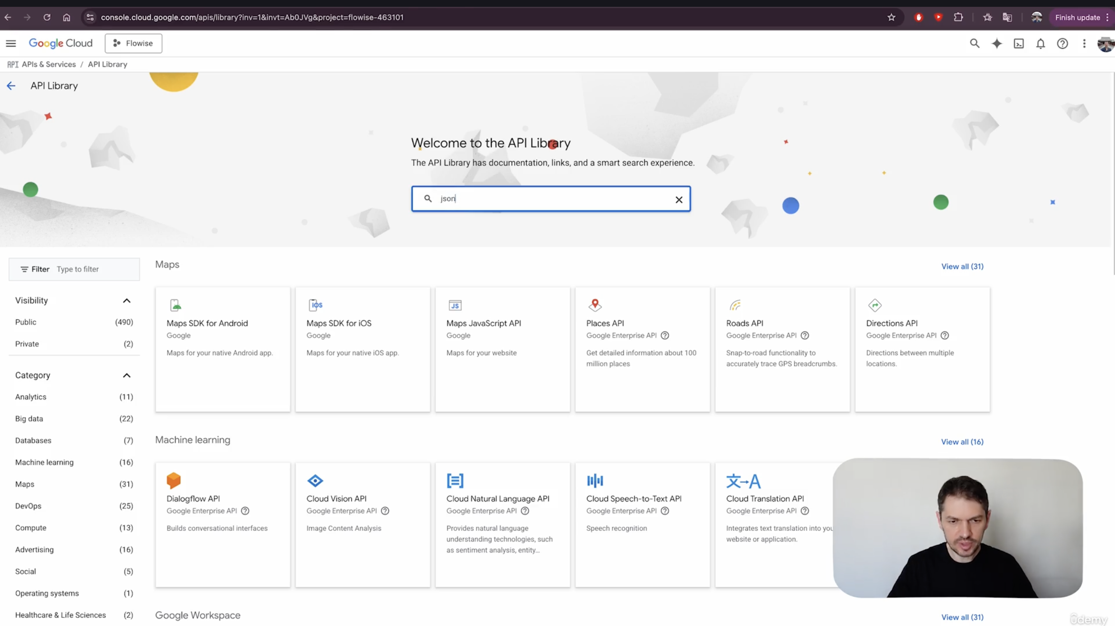
Search “json” in the dialogue box

Slide 22
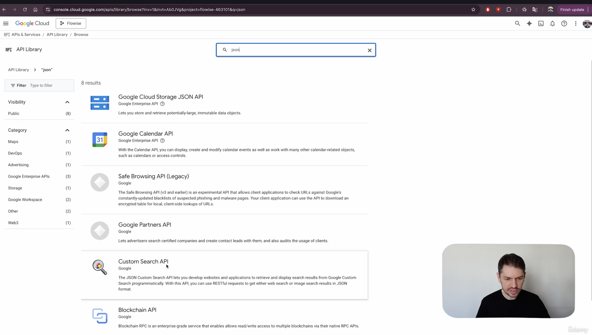
Use “Custom Search API”

Slide 23
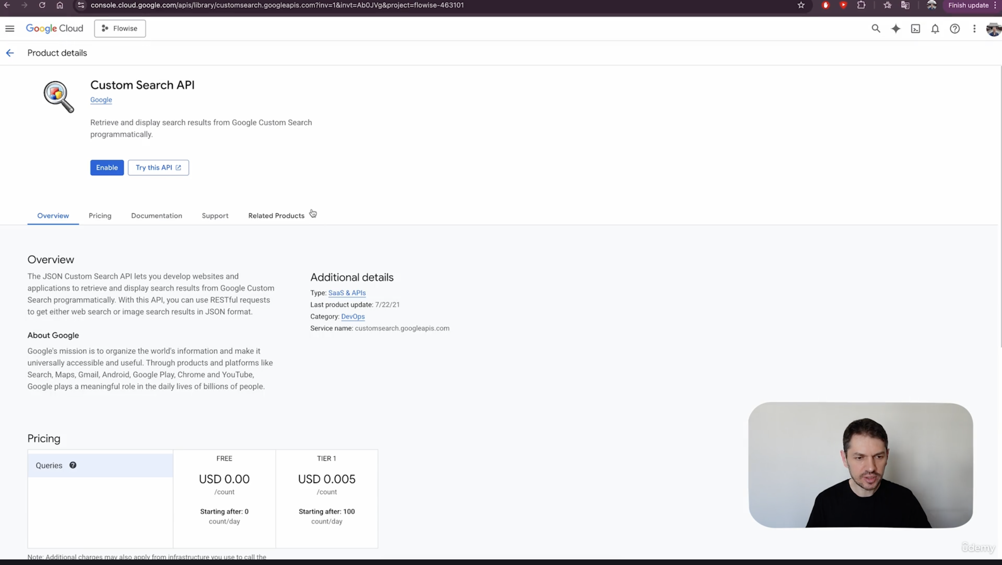
Enable the Custom Search API

Slide 24
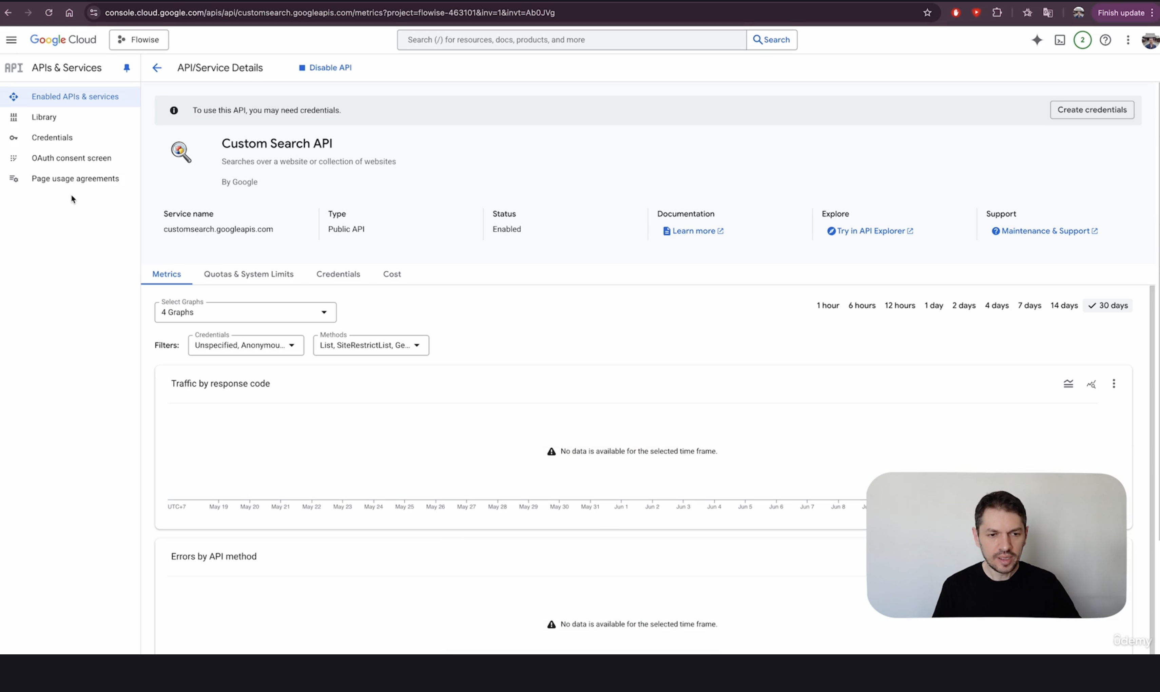
Once enabled, you will land on this screen

Slide 25
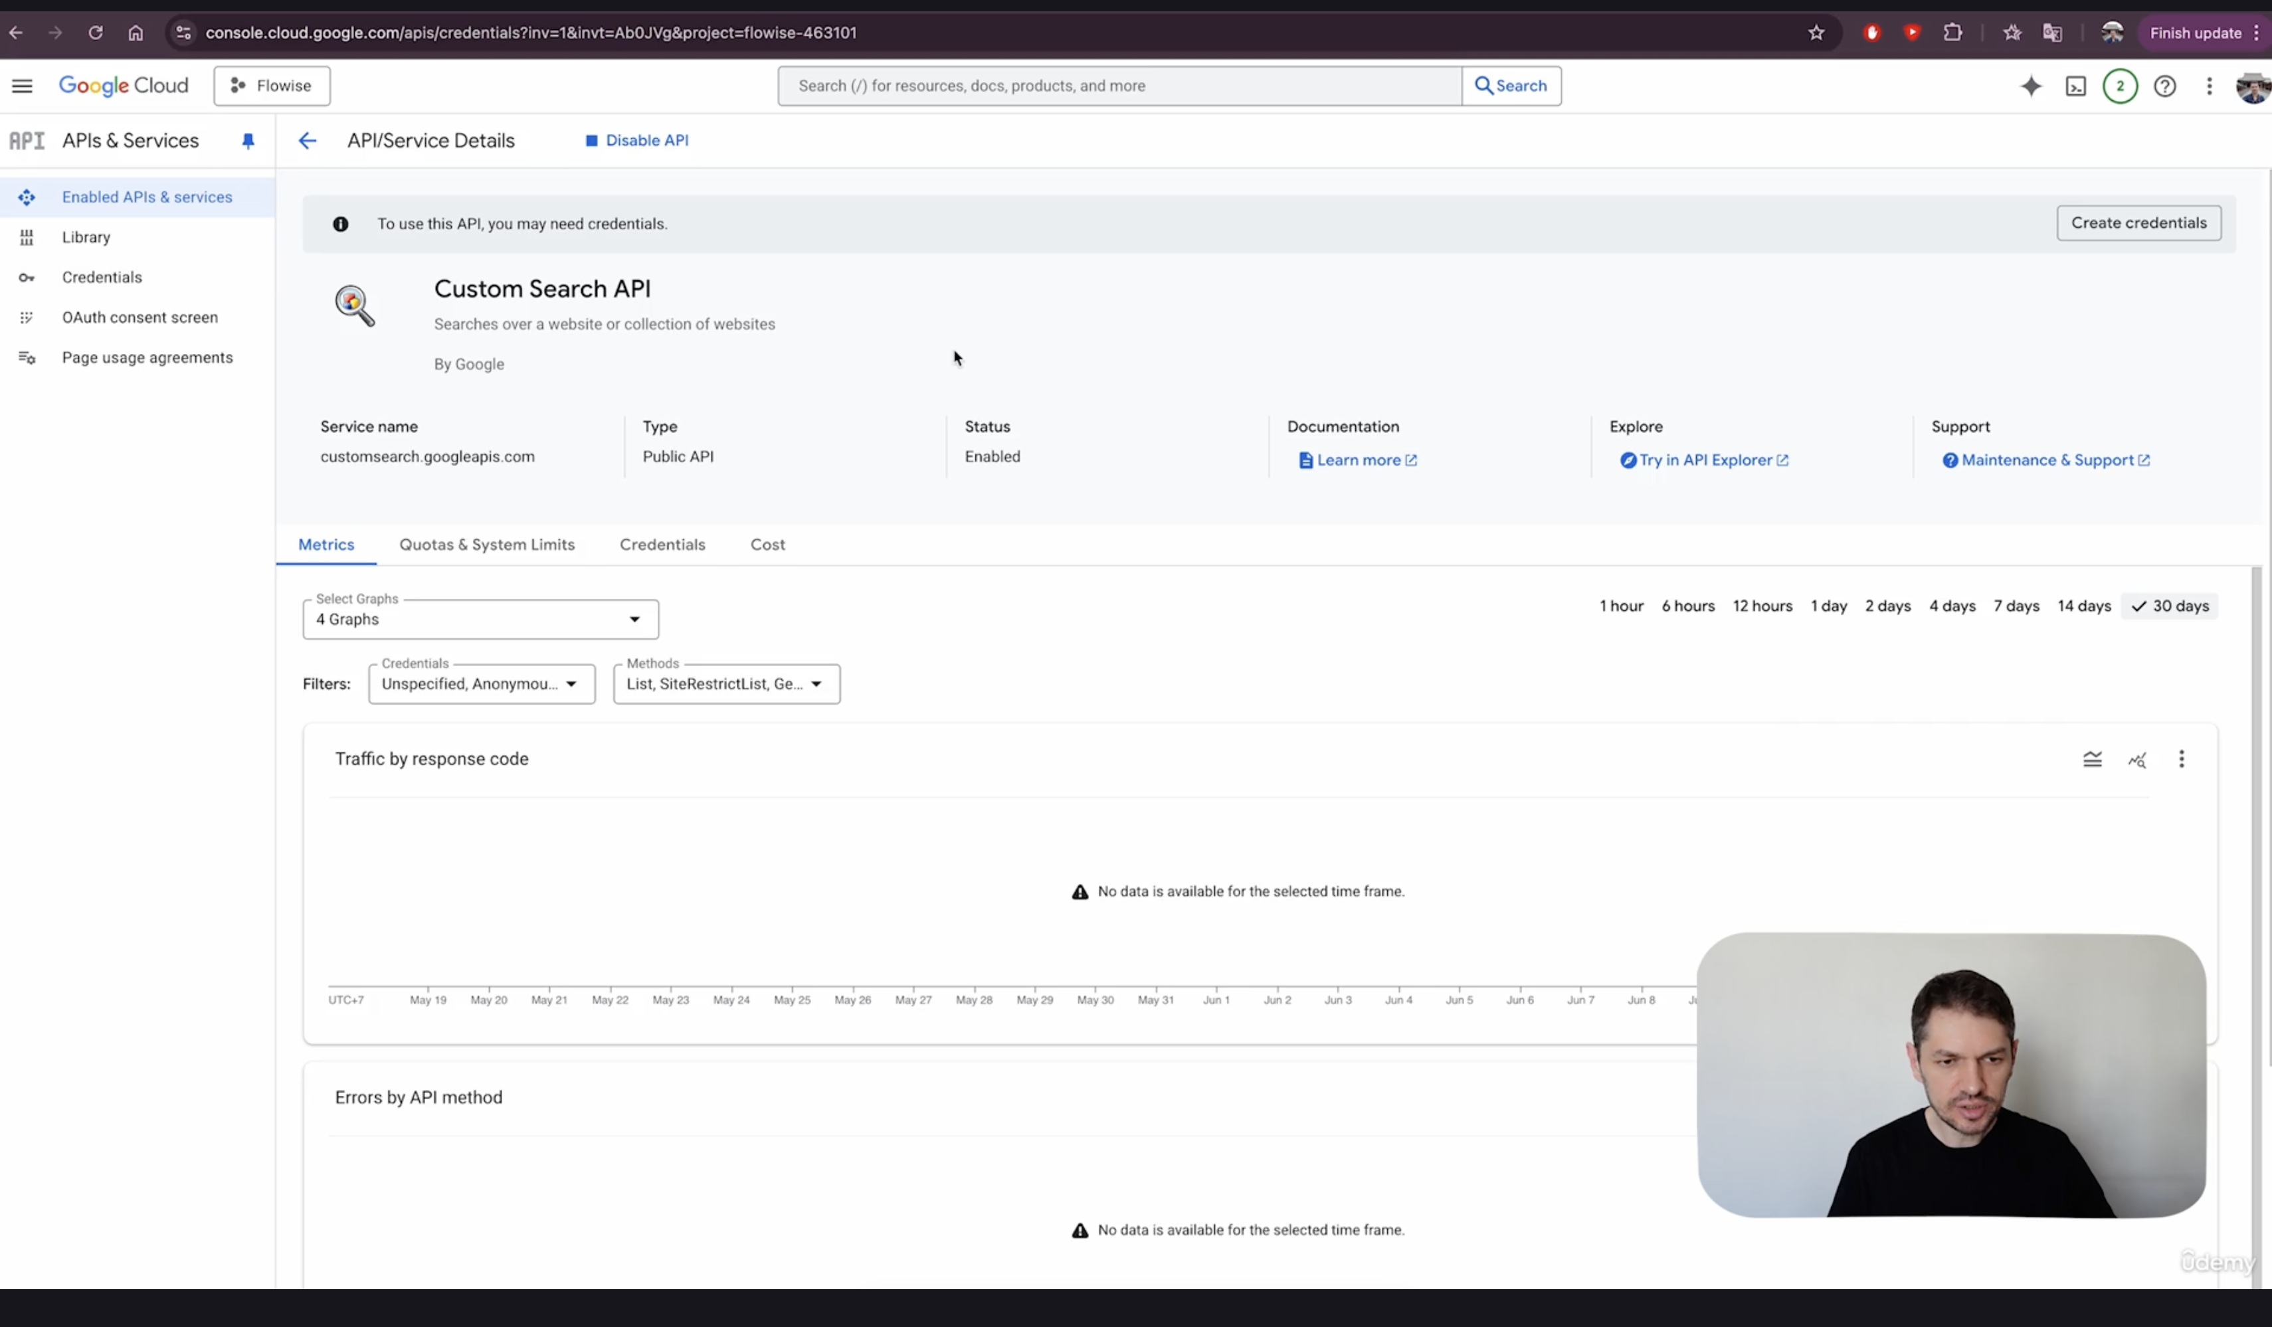
Go to “Credentials”

Slide 26
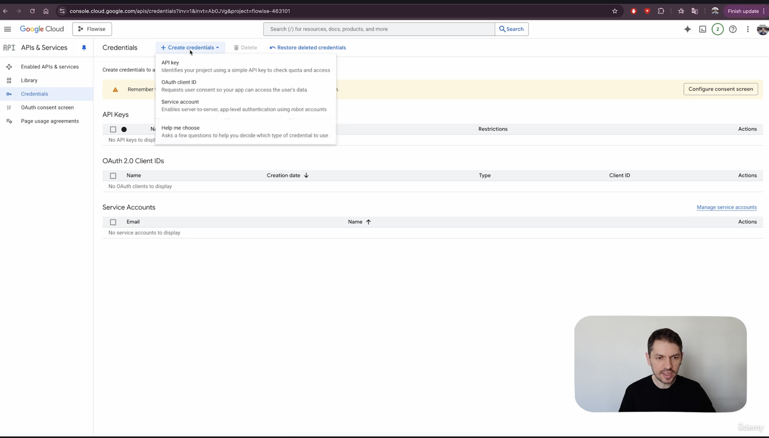
Select ”Create Credentials”
Then select “API key”

Slide 27
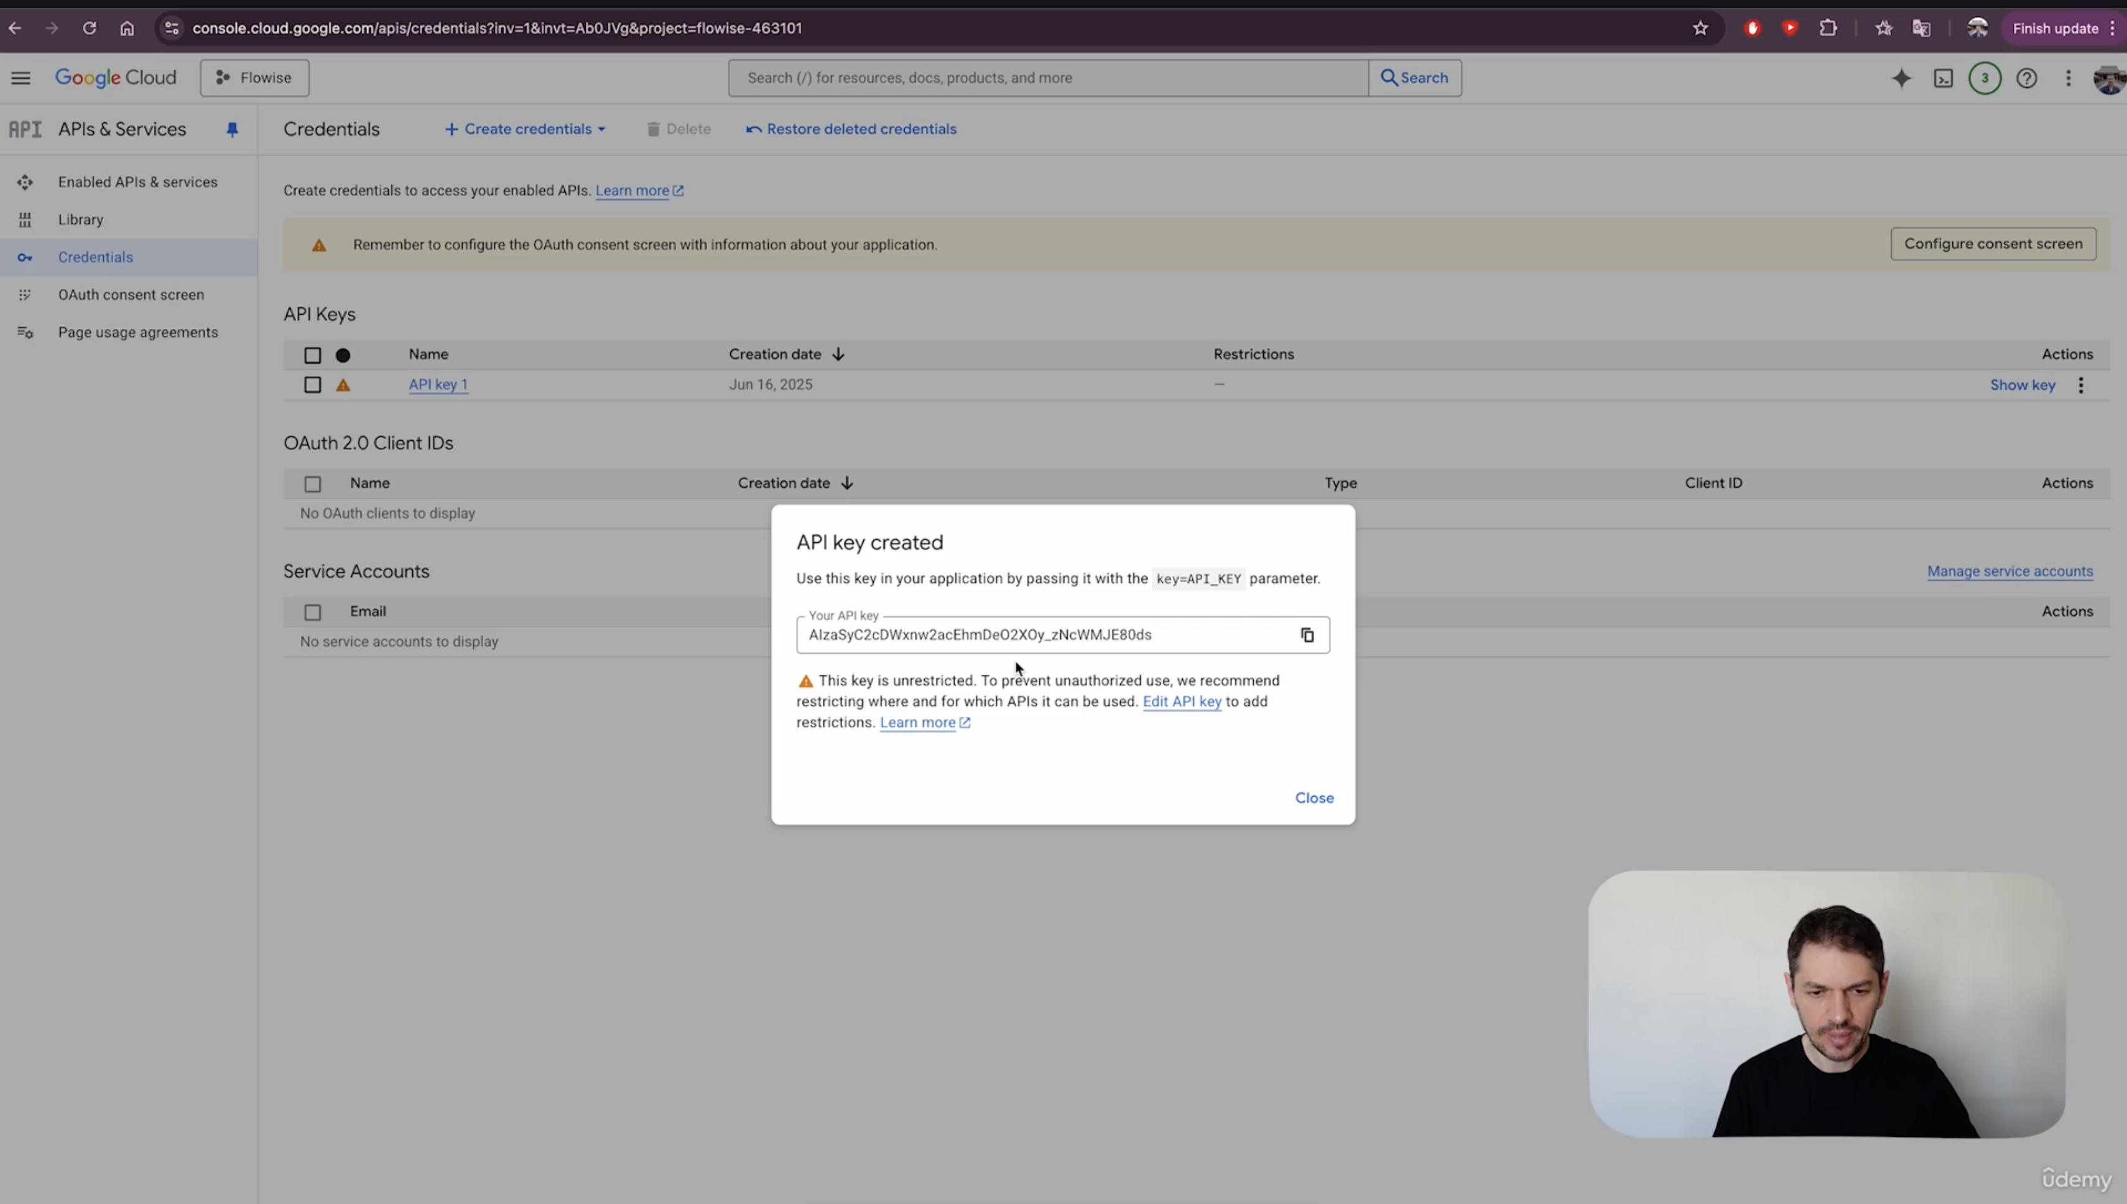
Your API Key will get generated

